Slide 1
Customer Demographics and Purchase Behavior Analysis
Pushparaj / BADM-WD-T-B9

Slide 2
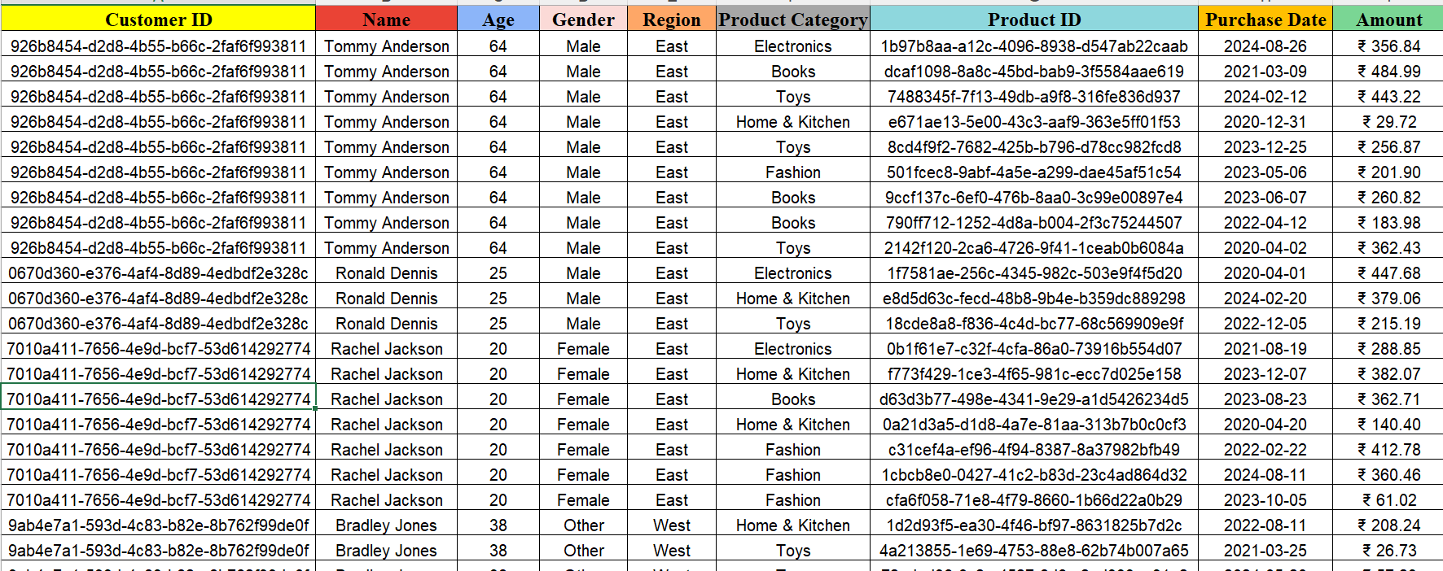
Task 1: Styling Tabulation Format the dataset to improve readability Bold headers, apply alternating row colors, and format the amount column as currency.

Slide 3
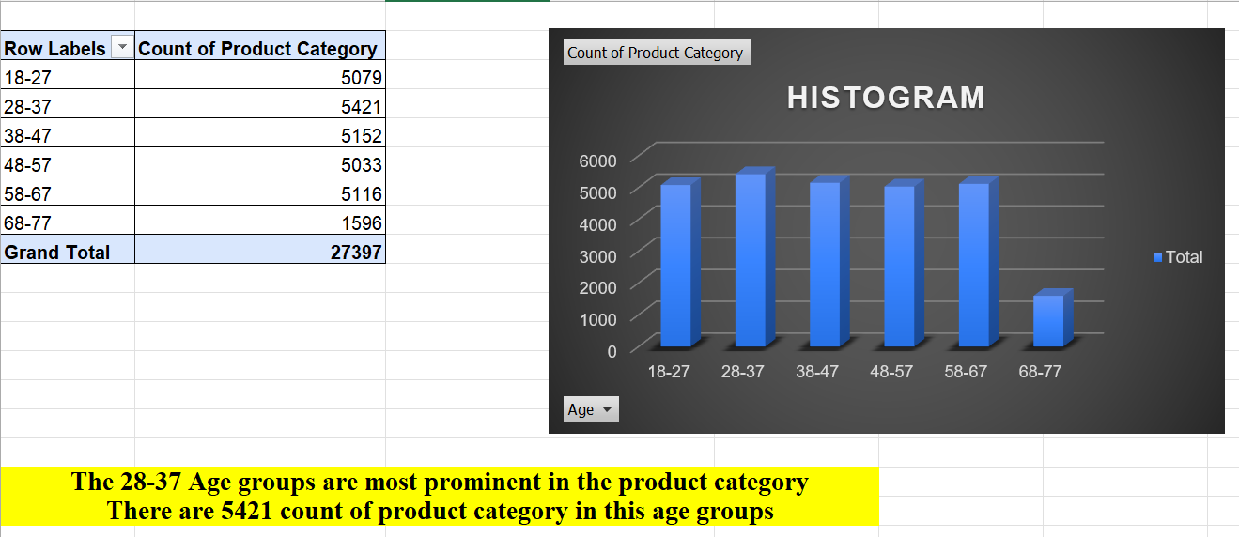
Task 2: Age Distribution Histogram Visualize customer age distribution. Group ages into bins and create a histogram to analyze which age groups are most prominent.

Slide 4
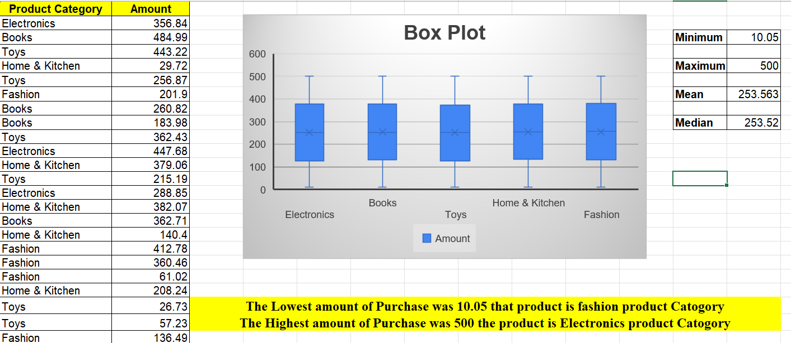
Task 3: Box Plot for Purchase Amounts Examine the variability in amount spent across product categories. Plot a box plot to identify outliers and the median purchase amounts.

Slide 5
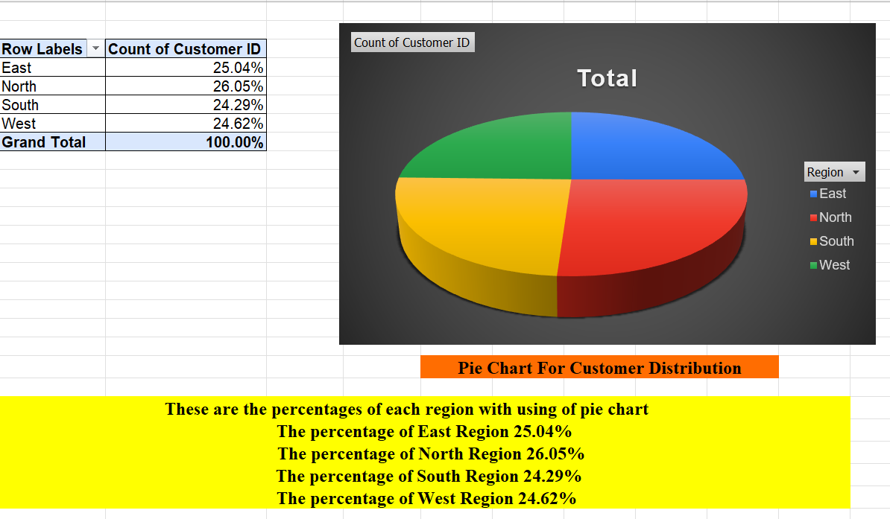
Task 4: Pie Chart for Customer Distribution Represent the percentage of customers in each region with a pie chart. Display percentages and highlight the region with the highest customer base.

Slide 6
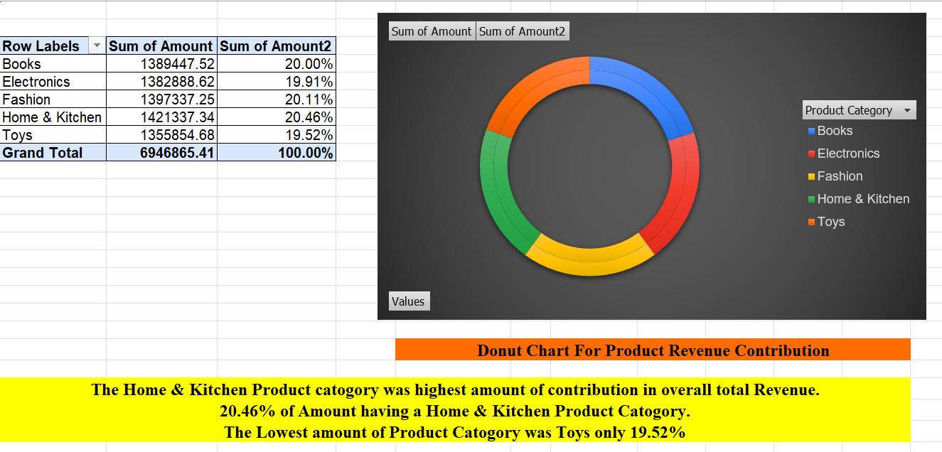
Task 5: Donut Chart for Product Revenue Contribution Show the contribution of each product category to the total revenue. Use a donut chart to display the data visually.

Slide 7
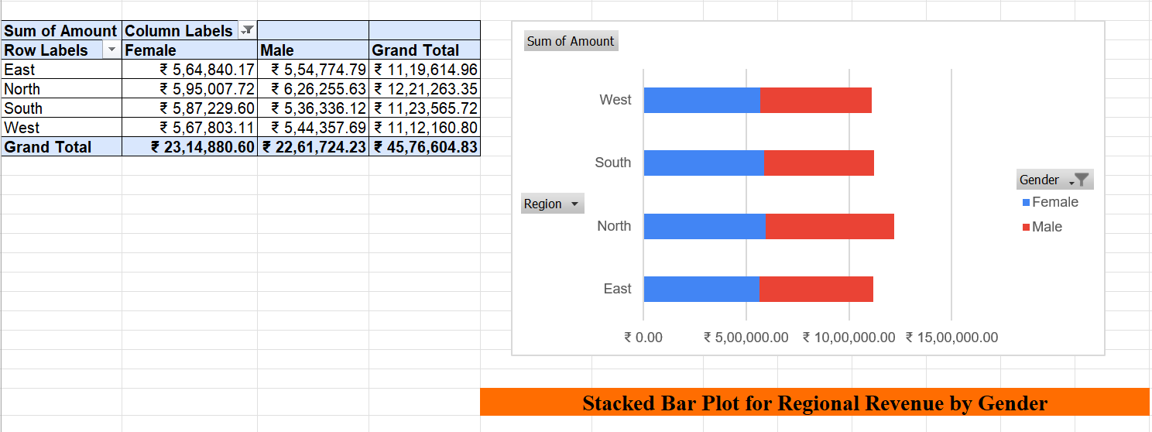
Task 6: Stacked Bar Plot for Regional Revenue by Gender Analyze total revenue by region, segmented by gender. Create a stacked bar plot for better comparison.

Slide 8
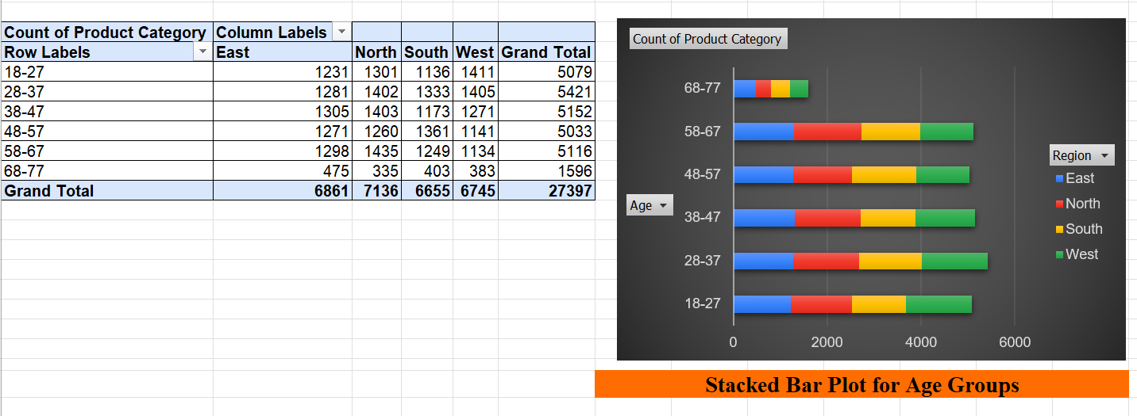
Task 7: Relative Stacked Bar Plot for Age Groups Visualize the proportion of purchases made by different age groups in each region represent data proportionally in a stacked bar plot.

Slide 9
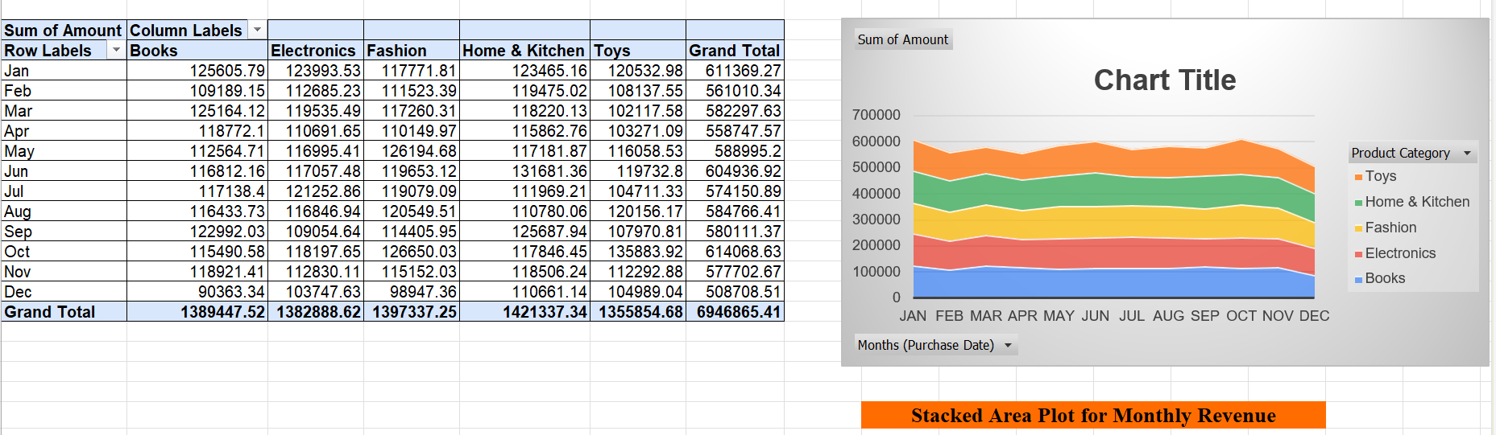
Task 8: Stacked Area Plot for Monthly Revenue Analyze monthly revenue trends across product categories. Use a stacked area plot to observe how each category contributes over time

Slide 10
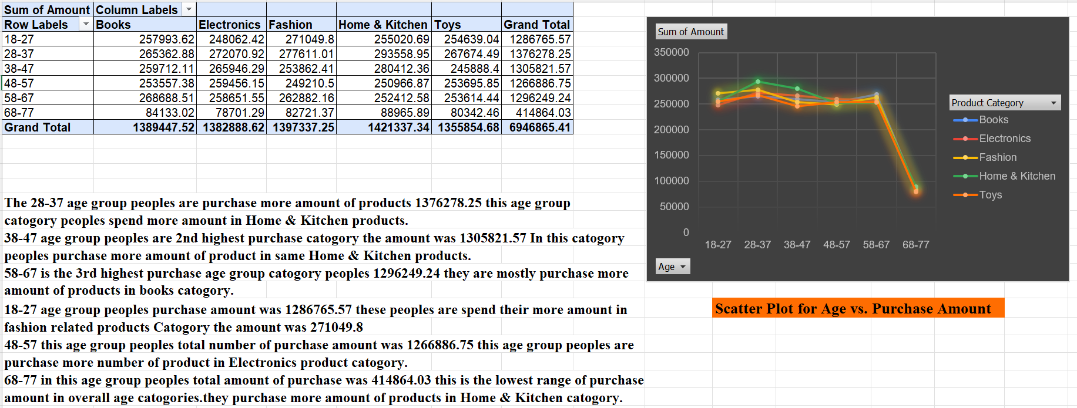
Task 9: Scatter Plot for Age vs. Purchase Amount Explore the relationship between age and amount. Use a scatter plot to identify patterns or trends in spending behavior.

Slide 11
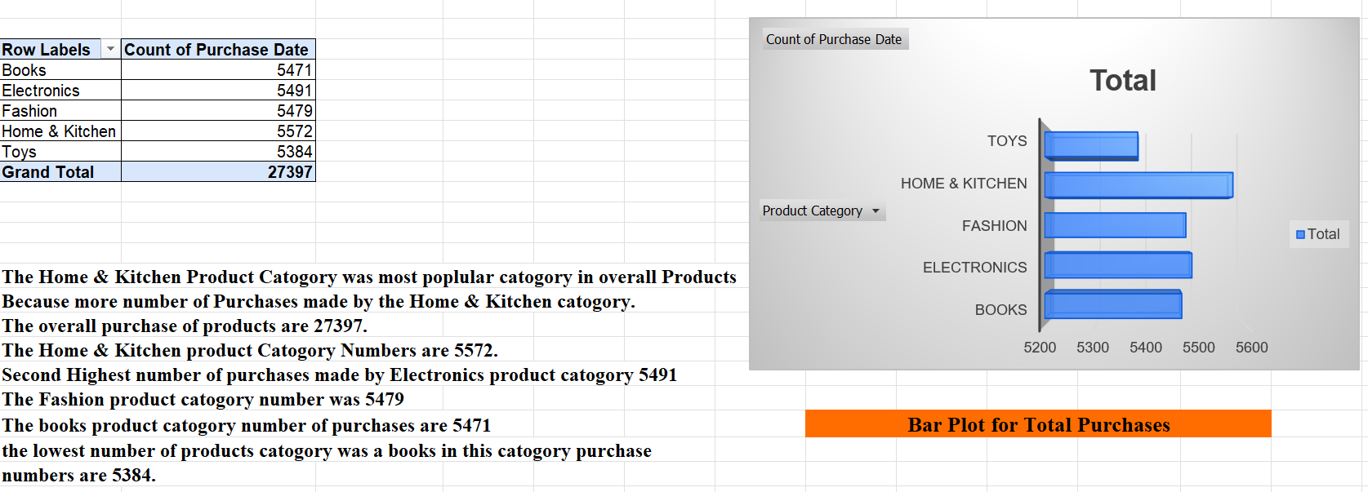
Task 10: Bar Plot for Total Purchases Compare the total number of purchases across product categories. Create a bar plot to identify the most popular categories.

Slide 12
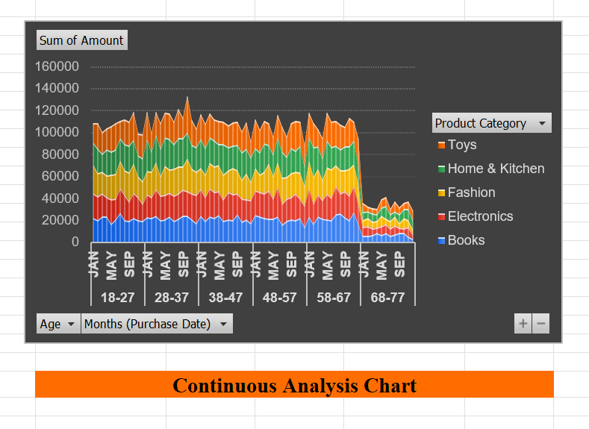
Task 11: Continuous vs Continuous Analysis Visualize how purchase amounts vary with customer age. Plot continuous variables to identify correlations or trends.

Slide 13
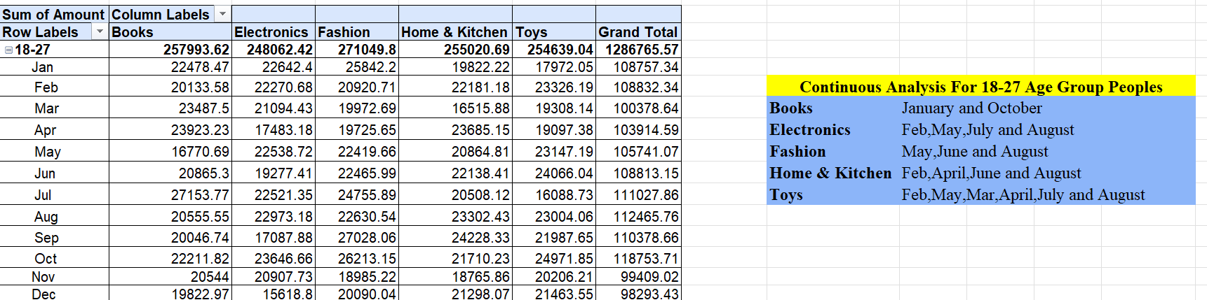
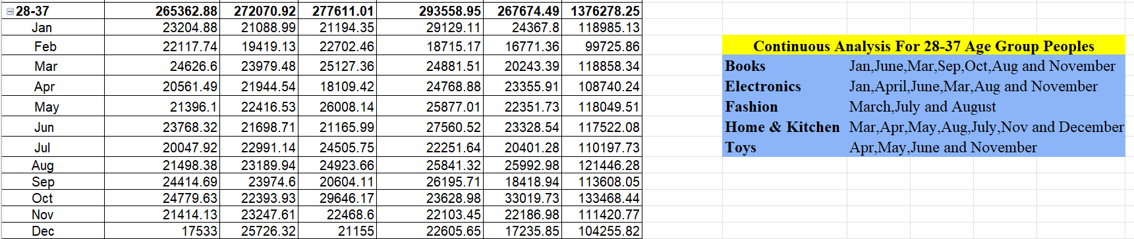
18-27 Age Group Peoples
28-37 Age Group Peoples

Slide 14
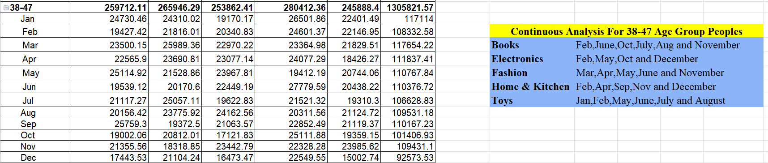

38-47 Age Group Peoples
48-57 Age Group Peoples

Slide 15

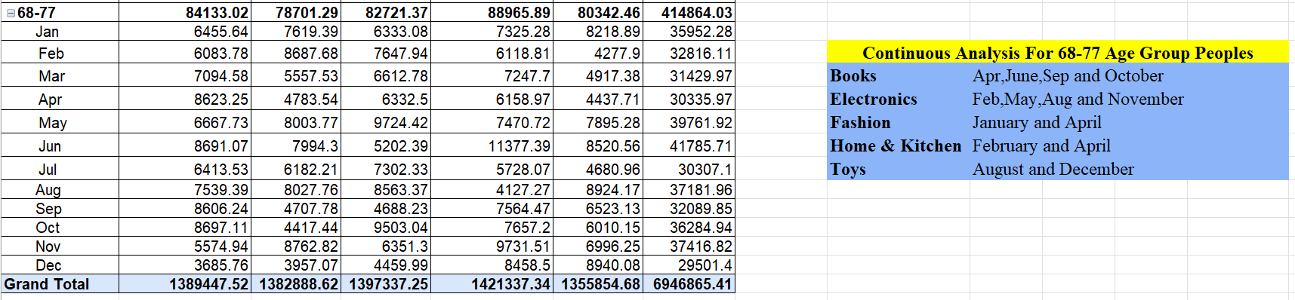
58-67 Age Group Peoples
68-77 Age Group peoples

Slide 16
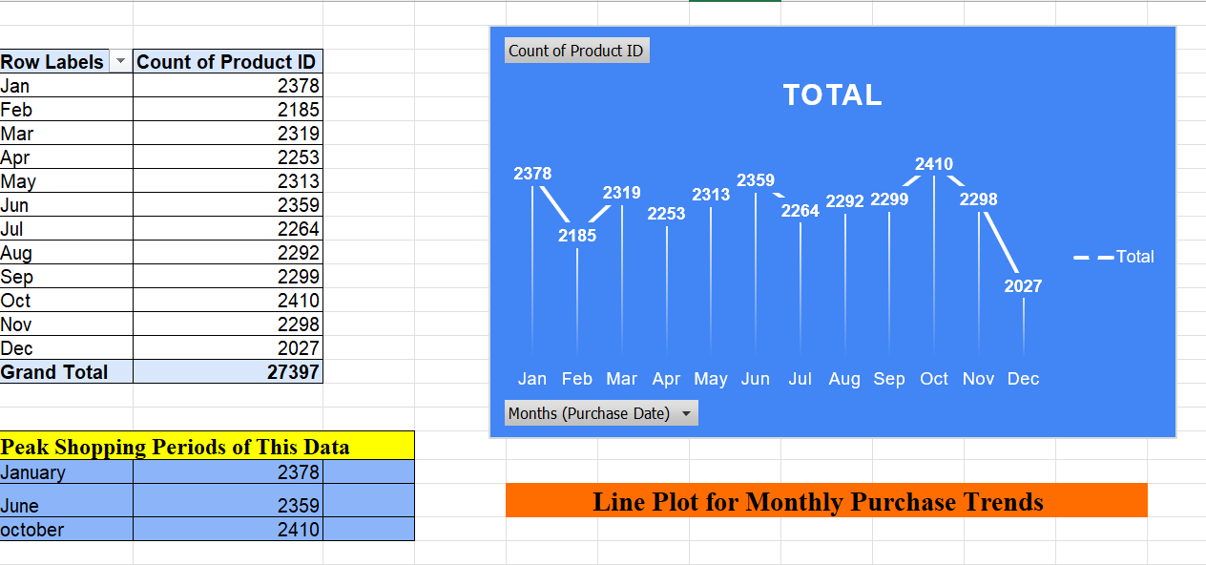
Task 12: Line Plot for Monthly Purchase Trends Track the number of purchases made in each month. Use a line plot to identify peak shopping periods

Slide 17
Excel Worksheet
https://1drv.ms/x/c/8248691ca8b8443f/EVDSi7yIiitFjRgxMHALVdQBmW0XyPNRa1Ji2rhqKOSIBg?e=ErNtoB

Slide 18
Thank you

